Slide 1

Fake News Detection with Unsupervised Learning
DSCC 440 Data Mining
Jordan Pappas, Isaac Manly

Slide 2
Introduction / Motivation
Social media is increasingly relied upon by Americans for news updates.
In 2019, the Pew Research Center found that 4 in 10 Americans consume news on Facebook and that 52% of survey respondents have changed their social media behavior due to the issue of fake news¹.
This increased reliance on social media for news, without proper fake news filtering, can have devastating effects.
Early in the novel coronavirus pandemic, Italy was one of the hardest hit countries. A group of researchers at the University of Florence studied the circulation of fake news during this period. Of their sample, 23.1% of total shares containing a website link were fake.
They found that fake news “indubitably” impacted health communications during the pandemic⁶.
Thus, in a global health crisis, implementations of fake news detection models by social media providers may save lives.

Slide 3
Literature Review
Supervised learning techniques:
In 2019, Khan, Afroz, et al. studied the efficacy of popular classification methods. Their models focused on the content of the news articles which includes the word count, subject, sentiment, number of nouns, etc. of the text within the articles. Their accuracies ranged from 0.54 to 0.95, with Naive Bayes performing the best³.
Network graph models:
A study by Alexandre Bovet and Hernan Makse used this approach to determine that during the 5 months preceding the 2016 election, 25% of news-related tweets spread either fake or extremely biased news. They found significant differences between graph densities given political leaning.
Bayesian network models:
In 2019, Yang, Shu, et al. leveraged a Bayesian network model to capture the conditional probabilities between the truth of news, the user’s opinion, and the credibility of news. Their method used both the context and content of tweets to model the truth of user’s posts. Their accuracy was 0.76 on the Liar dataset, and 0.68 on the Buzzfeed dataset⁷.

Slide 4
Problem Statement
Traditionally, supervised learning methods have been used to tackle fake news detection, but there is one serious limitation to this family of techniques: the data must be reliably labeled before training.
Unsupervised learning methods, however, avoid this limitation, as they don’t require labels.
Additionally, unsupervised learning will be more generalizable than supervised learning, because supervised learning will only perform well on news topics that it has been trained on beforehand, while unsupervised learning requires no training at all.
Accordingly, we will explore the predictive value of unsupervised clustering, including hierarchical and partitioning methods, using both the content and context of news article data.

Slide 5
Datasets
Kaggle Fake News | Liar
Included approximately 13,000 samples. Features Included: Headline Text Subject Date | Included Approximately 44,000 samples. Features Included: The ID of the statement ([ID].json). The label. The statement. The subject(s). The speaker. The speaker's job title. The state info. The party affiliation. Barely true counts. False counts. Half true counts. Mostly true counts. Pants on fire counts. The context (venue / location of the speech or statement). Columns 9 - 13 were converted to 1 binary T/F feature

Slide 6
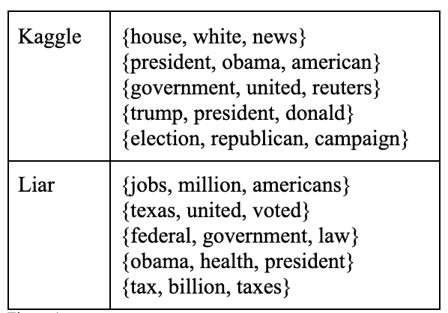
Topic Exploration
LDA topic modeling:
Used to understand the subjects covered in the data
Topic modeling shows that our data is predominantly political in nature.

Slide 7
Preprocessing: Text
Remove unnecessary words:
stopwords: remove common words that do not have much meaning
punctuations: remove common punctuations that do not have much meaning
Keep informative words:
emojis: 😋, 😢…etc
special characters: “:)“, “><”…etc
some punctuations: “!!”, “~”, “…”…etc
Stem tokens:
cut off the end or the beginning of the word by taking into account a list of common prefixes and suffixes that can be found in an inflected word

Slide 8
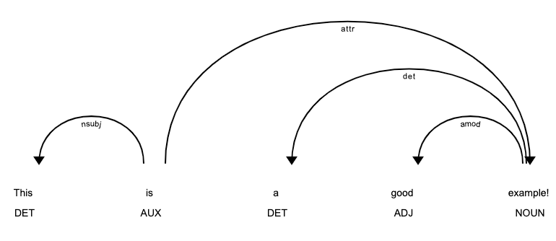
Preprocessing: LIWC
For LIWC, we implemented an NLP package named spaCy.
For each observation, the number of adverbs, nouns, adjectives, and proper nouns out of the total word count were calculated.
Below is an example of how spaCy processes language.

Slide 9
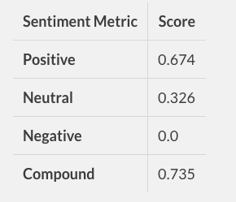
Preprocessing: Vader Sentiment Analysis
Vader Sentiment Analysis was implemented to capture the sentiment of a text article.
The process relies on a dictionary that maps lexical features to emotion intensities.

Slide 10
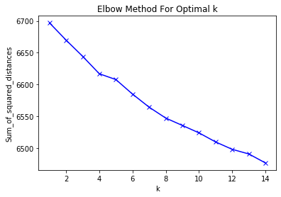
Preprocessing: Term Frequency - Inverse Document Frequency(tf-idf)
Clustering of tf-idf involved applying KMeans clustering to word frequency vectors of the text.
Works by grouping similar texts together, using their cluster label as the feature
There was no clear elbow, so we chose K = 8 after multiple trial evaluations.

Slide 11
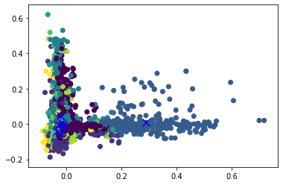
Preprocessing: Text Clustering with KMeans
Created a feature that clustered the most similar text frequency vectors
PCA was used to transform the clustered data into 2 components.

Slide 12
Data Modeling
BIRCH.
Features:
Content, context, and combination of content and context from Liar dataset
Content from Kaggle dataset
KMeans
Features:
Content, context, and combination of content and context from Liar dataset
Content from Kaggle dataset
The evaluation for these models will be similar to that of standard classifiers. Since we are attempting to differentiate our data into two clusters, true and false, those cluster labels will be interpreted as their class label. For instance, a perfect unsupervised method, consisting of only true articles in one cluster, and false in the other, would have an accuracy of 1.

Slide 13
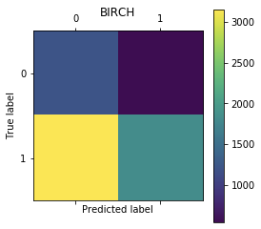
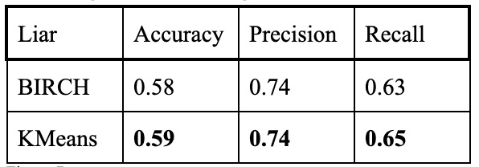
Model Evaluation: Context
The two methods perform similarly on Liar, but partitioning performs slightly better.
The content features used included party, word count, location of speaker, and the topic of the speaker.

Slide 14
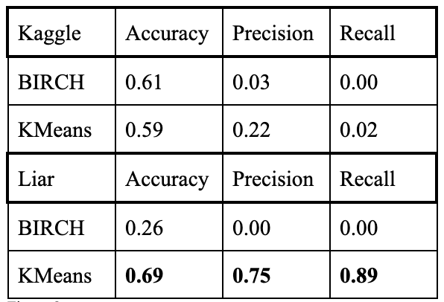
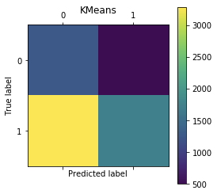
Model Evaluation: Content
Both methods perform decently on the kaggle dataset with respect to accuracy. However, BIRCH performance drops rapidly on the Liar dataset. This is due to BIRCH assigning the majority of observations to one cluster. KMeans performs well on the content of the Liar dataset with an accuracy of 0.69.
The content features used were the percentage of different parts of grammar, word count, sentiment, and tf-idf cluster.

Slide 15
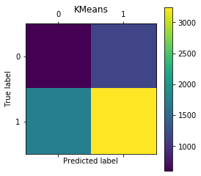
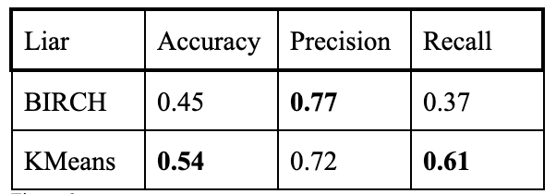
Model Evaluation: Context / Content
The two methods perform similarly on Liar, but partitioning performs better on accuracy and recall.
This is likely due to the high dimensionality of combining context and content features and the added noise from each additional feature.
The features used were the features from both the content and context sections above.

Slide 16
Conclusion
We approached the task of fake news detection with unsupervised learning by using their content and context. This task is considerably more difficult than implementing supervised learning. To engineer our content features, we employed sentiment analysis, clustering of tf-idf’s, and LIWC from two datasets: Liar and Kaggle Fake News. After extracting new content features, we tested algorithms BIRCH and KMeans performance on the context, the content, and then both combined.
The best results were achieved by KMeans on the content of the Liar data, resulting in an accuracy of 0.69, a precision of 0.75, and a recall of 0.89. For this task, partitioning methods are likely better than hierarchical clustering.
Future work in the area should explore alternative methods of feature extraction from the content of text. For example, we did not represent all parts of speech from the text. Other types of unsupervised learning should also be tested, especially those that cannot be implemented as a binary classifier.

Slide 17
References
[10] Bisaillon, Clément. “Fake and Real News Dataset.” Kaggle, 26 Mar. 2020, www.kaggle.com/clmentbisaillon/fake-and-real-news-dataset.
[2] Bovet, Alexandre, and Hernán A. Makse. “Influence of Fake News in Twitter during the 2016 US Presidential Election.” Nature News, Nature Publishing Group, 2 Jan. 2019, www.nature.com/articles/s41467-018-07761-2.
[5] Darley, John, and Paget Gross. “A Hypothesis-Confirming Bias in Labeling Effects.” Dimensions, 1983, app.dimensions.ai/details/publication/pub.1001508409.
[1] Geiger, A.W. “Key Findings about the Online News Landscape in America.” Pew Research Center, Pew Research Center, 30 May 2020, www.pewresearch.org/fact-tank/2019/09/11/key-findings-about-the-online-news-landscape-in-america/.
[11] Han, Jiawei., Micheline Kamber, and Jian Pei. Data Mining: Concepts and Techniques, Third Edition. 3rd ed. Waltham, Mass.: Morgan Kaufmann Publishers, 2012.
[3] Khan, Junaed Younus, et al. “[PDF] A Benchmark Study on Machine Learning Methods for Fake News Detection: Semantic Scholar.” arXiv, 1 Jan. 1970, www.semanticscholar.org/paper/A-Benchmark-Study-on-Machine-Learning-Methods-for-Khan-Khondaker/09adaadcd4cc3e7aafef6573df7cab133cb9517b.
[6] Moscadelli, Andrea, et al. “Fake News and Covid-19 in Italy: Results of a Quantitative Observational Study.” MDPI, Multidisciplinary Digital Publishing Institute, 12 Aug. 2020, www.mdpi.com/1660-4601/17/16/5850.
[4] Nelson, Jacob, and Harsh Taneja. “The Small, Disloyal Fake News Audience: The Role of Audience Availability in Fake News Consumption.” SSRN, 30 Jan. 2018, papers.ssrn.com/sol3/papers.cfm?abstract_id=3107731.
[8] Siva Charan Reddy Gangireddy Indraprastha Institute of Information Technology, et al. “Unsupervised Fake News Detection: A Graph-Based Approach.” Unsupervised Fake News Detection | Proceedings of the 31st ACM Conference on Hypertext and Social Media, 1 July 2020, dl.acm.org/doi/10.1145/3372923.3404783.
[9] thiagorainmaker77. “thiagorainmaker77/liar_dataset.” GitHub, github.com/thiagorainmaker77/liar_dataset.
[7] Yang, Shuo, et al. “Unsupervised Fake News Detection on Social Media: A Generative Approach.” Proceedings of the AAAI Conference on Artificial Intelligence, ojs.aaai.org//index.php/AAAI/article/view/4508. .

